Slide 1
JWS Architecture
Service-Oriented Software Engineering
Software Institute
Nanjing University
Bei Jia

Slide 2
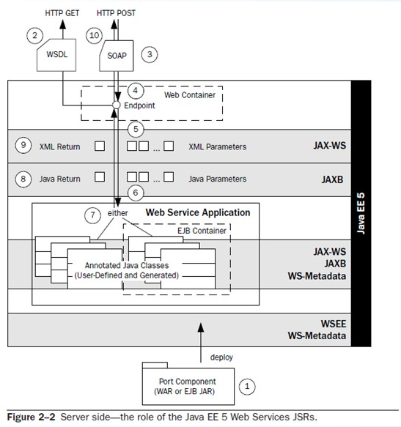

Server-Side Deployment and Invocation of a Web Service (1/5)
Corresponds to a function of the deployment subsystem in the WSPA
JWS defines the Port component (sometimes referred to as Port) as the server view of a Web service
  Port can be packaged as a WAR (for servlet endpoint) or as an EJB JAR (for EJB endpoint)
  WSEE defines the deployment process and the packaging structure
  WS-Metadata describes how annotations on the packaged classes shape the deployment (e.g., the WSDL)

Slide 3
Server-Side Deployment and Invocation of a Web Service (2/5)
Not officially part of the WSPA, but often included in invocation subsystem in the WSPA
The structure of WSDL is determined by the JAX-WS WSDL/Java mapping, which can be customized using annotations:
  The JAX-WS annotations manipulate the style of WSDL
  JAXB annotations manipulate the representation of Java parameters and return types as XML Schema components
  WS-Metadata annotations manipulate the particulars of the WSDL interface
The invocation is initiated when a SOAP request is received at the endpoint

Slide 4
Server-Side Deployment and Invocation of a Web Service (3/5)
Is a function of the deployment subsystem in the WSPA
The Web service’s endpoint is typically implemented by a servlet class listening at the endpoint URL specified during deployment
  It is part of the implementation of JWS
  During deployment, the annotations and/or deployment descriptors are read by the WSEE runtime, the endpoint URL is determined, and the container’s internals are configured to deploy the listener at that endpoint

Slide 5
Server-Side Deployment and Invocation of a Web Service (4/5)
Is a part of the dispatching process handled by the invocation subsystem in the WSPA
Maps to the serialization subsystem in the WSPA
The JAX-WS runtime extracts XML parameters from the SOAP message
The XML parameters are deserialized into Java parameters
  This deserialization is handled by the JAXB runtime
  The JAXB runtime uses introspection to examine the annotations on the target classes, and that information (together with the standard Java/XML binding defined by JAXB) is used to generate instances of the target parameters

Slide 6
Server-Side Deployment and Invocation of a Web Service (5/5)
Is a responsibility of the invocation subsystem in the WSPA
Server-side handler invocation, and exception processing are omitted
Then, the Java target is invoked
Java return type class is handed off for JAXB serialization to become an XML return type instance (controlled by the annotations on the Java return class)
The JAX-WS runtime takes the XML return type instance and wraps it in a SOAP response
Finally, the SOAP response is sent back to the requester as the payload of the HTTP response

Slide 7
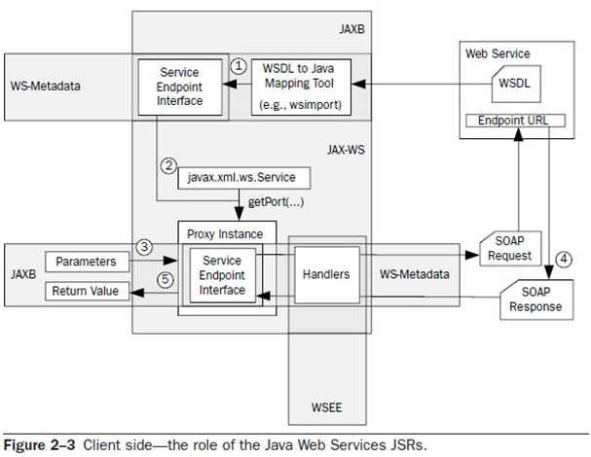
Client-Side Invocation of a Web Service (1/3)
Generating the SEI involves JAXB, JAX-WS, and WS-Metadata
Prior to compiling the client application, a SEI is generated using a WSDL to Java mapping tool
At runtime, an instance of the JAX-WS javax.xml.ws.Service class is used to provide the client view of the Web service to be invoked. One of the Service.getPort methods is used to obtain a run-time instance of the SEI. The run-time instance is implemented using Java proxy technology and is represented in as Proxy Instance

Slide 8
Client-Side Invocation of a Web Service (2/3)
Generated during creation of the SEI. They defined by the JAXB mapping from the schemas included in the WSDL
The invocation is started by invoking one of the SEI methods on the Proxy Instance
  Annotations are used to translate from the JAXB parameters and method invocation to the SOAP request
  Once the SOAP request has been generated, and before it is sent to the Web service endpoint, the handlers (attached by the WS-Metadata specification) are invoked

Slide 9
Client-Side Invocation of a Web Service (3/3)
After handler processing, the SOAP request message is sent to the Web service and a SOAP response is returned. The SOAP response is processed in the reverse order
  First, the handlers are applied
  Then, the SOAP response parameters are deserialized (via the JAXB runtime)
Lastly, the proxy instance returns a JAXB instance as the return value

Slide 10
Source Code Annotations
Source code annotations (defined by JAX-WS, WS-Metadata, and JAXB) for Web Services are introduced into JWS to help reduce deployment complexity
They are used within all three subsystems defined by the WSPA: invocation, serialization, and deployment
  e.g., With WS-Metadata annotations we can simply annotate the class being deployed to describe how it should map to a Web service. The JWS deployment subsystem generates the descriptors required by the container and Web Services platform
However…
  Annotations lead to more-complex and difficult-to-read source code
  And if you want to publish SOA-style Web Services interfaces for existing Java classes using this approach, you are going to have to either create wrapper classes with the necessary annotations or add annotations to the existing classes

Slide 11
Standard WSDL/Java Mapping (1/2)
JAX-WS defines a standard mapping of WSDL to/from Java. When a service implementation bean (SIB) with minimal source code annotations is deployed, the resulting WSDL is based on this default mapping
Having a default mapping makes it easier for a Java programmer, who may not understand much about WSDL or XML, to deploy a Web service and generate service endpoint interfaces (SEIs) from an existing WSDL automatically
However, while the standard mapping makes it easy to deploy a Web service, it is not clear that the result is useful

Slide 12
Standard WSDL/Java Mapping (2/2)
The standard mapping isn’t helpful if your Web service needs to conform to an existing WSDL contract
The annotations allow you to “shape” the resulting WSDL, but there are limitations on how far you can go with such customizations
  For example, you can’t map two operations on the same WSDL port to methods from two different SIBs
    If you have a wsdl:port with the operations foo and bar, both foo and bar must be mapped to methods on the same Java class or interface.
    One cannot map foo to MyClass.doFoo() and bar to AnotherClass.doBar()
  Even more basic, you can’t map a WSDL port to anything but a SIB—there is no capability to deploy a non-annotated class as a Web service

Slide 13
Standard Serialization Context (1/2)
JAXB has standard rules for (de)serializing XML Schema components to/from Java objects. Using JAXB limits the types of mappings that are supported, but greatly simplifies the specification of a Web service
Using the generated JAXB classes is fine if you are starting application development from scratch
  For example, it is not a problem to use the generated Po class that JAXB maps to imported:po
However, if you are deploying a Web service based on existing classes, JAXB may have less value
  For example, if you want to deploy a Web service that uses some XML Schema type for a purchase order (e.g., imported:po) using the JAXB framework, you are not going to be able to use your existing PurchaseOrder class. You will have to use the Po class generated by JAXB from imported:po

Slide 14
Standard Serialization Context (2/2)
There are two ways to deal with this problem:
  Customize the standard JAXB mapping to “shape” the resulting classes
    You may be able to add annotations to your PurchaseOrder class so that JAXB maps it to imported:po
    However, using annotations in this way is challenging, and many times, it is impossible to produce the mapping desired
  Use wrappers to map existing classes to the JAXB-generated code
    You would write Java code to translate between the generated po class and your existing PurchaseOrder class
    The wrapper approach essentially boils down to storing your Java/XML mappings as Java code, which is not generally recommended because it is difficult to debug and complicates change management
      For example, if the imported:po schema changes, the generated class po also changes, and you will then need to update your wrapper code

Slide 15
Development Modes (SFJ & SFW)
“Start from Java” (SFJ) development mode is the only development mode that is required by WS-Metadata implementations
  You start with the development of a Java class, then deploy that class as a Web service, for the most part, is to annotate it with @WebService. The JAX-WS and JAXB run-time engines will map that class to a WSDL document using the standard mappings
  In SFJ mode, if you need to tweak the shape of your WSDL or XML types, that can be done by adding annotations to your class
JWS also defines the “Start from WSDL” (SFW) development mode
  You take a preexisting WSDL and use a WSDL compiler (provided as part of the JAX-WS implementation) to generate a set of Java program elements (SEIs) that implement the WSDL
  Then your job is to implement the SEIs with the appropriate business logic to implement the Web services defined by the WSDL

Slide 16
Development Modes (SFWJ) (1/3)
Finally, the JWS specifications also mention a “Start from WSDL and Java” (SFWJ) development mode
  You reference a preexisting WSDL from the @WebService annotation on the Java class intended to implement it. The annotations on this class must map the class to the referenced WSDL. If there is a mismatch, failure will occur at some point in the development or deployment process
  It requires you to be intimately familiar with how the annotations shape the WSDL. In addition, you may even unwittingly start out with a Java class that is simply impossible to map to the referenced WSDL using the annotations
  Making this approach work will require vendors to provide good tools that give programmers intelligent feedback on how to best use annotations to map the Java class to the referenced WSDL

Slide 17
Development Modes (SFWJ) (2/3)
How to map the WSDL structure to the Java methods and parameters of existing classes is the problem most commonly faced by developers who are using Web Services for systems integration—either internally or with business partners
  Developers doing integration often start with a WSDL contract that needs to be implemented (e.g., a specification for a business partner’s e-Business interface or an SOA service needed for an internal EAI project)
  Developers doing integration also usually start with some existing classes (e.g., the purchasing system)
In SFWJ development mode, you have preexisting XML schema types that must map to preexisting Java objects (parameters and return type). The problems can not be solved elegantly without a highly customizable serialization subsystem

Slide 18
Development modes (SFWJ) (3/3)
Almost any Web Services platform that attempts to simplify the serialization problem ends up introducing the need for wrapper code in order to solve SFWJ problems
  Developers use the JAX-WS WSDL compiler to generate a SEI from the existing WSDL, following the SFW development mode
  Then, this SEI is mapped to the existing classes using wrappers
On the other hand, there is a case to be made that the SFWJ development mode is actually the easiest to deal with because when both the WSDL and the Java are defined, the developer does not need to do any design work
  But from a developer’s point of view, SFWJ is the most difficult problem to solve using the JWS tools. JWS can’t help you very much when it comes to mapping existing Java to existing XML Schema and WSDL

Slide 19
Trade-Offs
As discussed previously, each of the JWS simplifications trade off against the capability of the Web Services platform to create and deploy useful Web Services
For example, the JWS SFJ development mode makes it easy to deploy a Web service, but…
  How useful is that Web service?
  Is it compliant with your enterprise or industry XML Schema standard types?
Beyond the JWS?
  Workloads vs. Simplifications

Slide 20
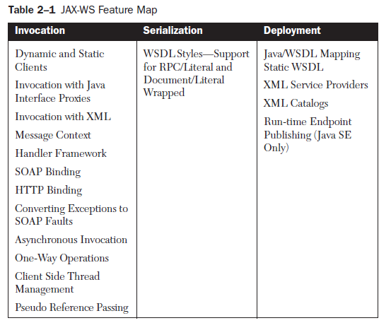
JAX-WS 2.0
JAX-WS 2.0 specifies the invocation subsystem of JWS, part of the deployment subsystem, and even a little bit of the serialization subsystem
It is a follow-on specification to JAX-RPC 1.1 and offers many improvements to that specification

Slide 21
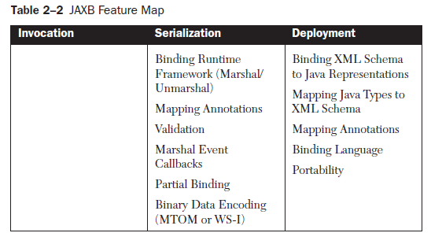
JAXB 2.0
JAXB 2.0 defines a standard Java/XML binding from Java representations (e.g., classes, bean properties) to XML Schema components (e.g., elements, types, attributes) and vice versa
JAXB 2.0 make it easy for Java programmers to work with XML instances of the schema
  SFJ: the Java classes exist first and are used to generate an XML schema via a schema generator. The classes need not be explicitly annotated, because JAXB 2.0 defines defaults to supply implied annotations wherever needed
  SFW: the schema(s) exists first and the Java classes in the data binding are created using a JAXB 2.0 schema compiler

Slide 22
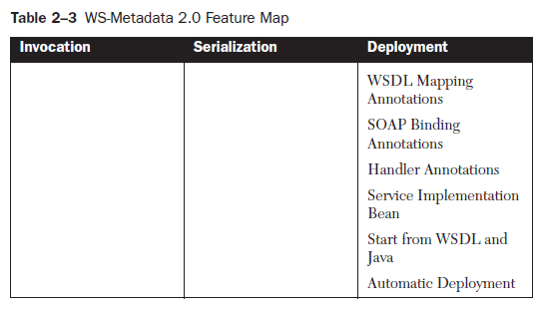
WS-Metadata 2.0
WS-Metadata features are all related to Web Services deployment
WS-Metadata annotations are used for different purpose
  Mapping annotations
  SOAP binding annotations
  Handler annotations

Slide 23
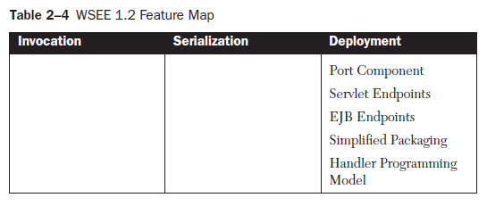
WSEE 1.2
The WSEE 1.2 specification defines a service architecture and packaging to ensure portability of Web services across Java EE application server implementations
The deployment complexity has been greatly reduced through the use of annotations as described in together with the simplified architecture and packaging
The WSEE 1.2 features are all deployment-related

